Slide 1
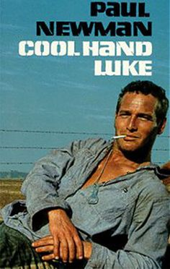
(cool hand luke)
How does Cool Hand Luke embrace the ideals of Transcendentalism? 1 paragraph
Explain how the character of Luke is a Christ symbol in the film. What other religious symbolism did you notice during the film? Use specific examples to support your assertions. (1 paragraph)
Cool Hand Luke was released in 1967, during the middle of the Vietnam War. Discuss how the film’s themes of anti-establishment and non-conformity were reflections of American society’s attitude toward the war.
(1 paragraph)

Slide 2
(cool hand luke)
How does Cool Hand Luke embrace the ideals of Transcendentalism? 1 paragraph
Explain how the character of Luke is a Christ symbol in the film. What other religious symbolism did you notice during the film? Use specific examples to support your assertions. (1 paragraph)
Cool Hand Luke was released in 1967, during the middle of the Vietnam War. Discuss how the film’s themes of anti-establishment and non-conformity were reflections of American society’s attitude toward the war.
(1 paragraph)

